Slide 1
CUSTOMER ANALYSIS

Slide 2
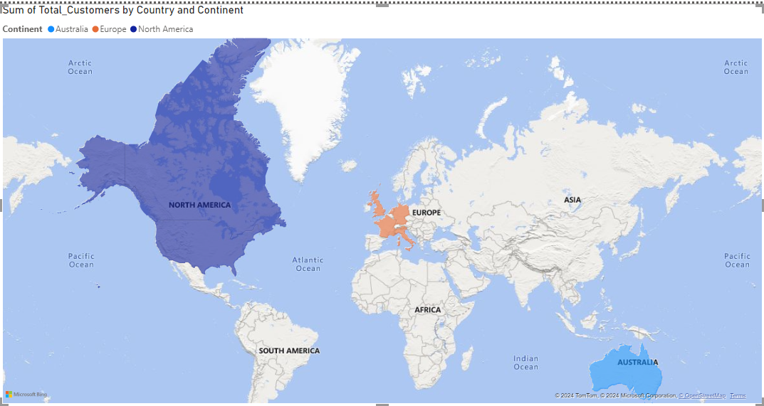
Demographic Distribution: Distribution Of Customer On Basis Of Country , Age, Gender,

Slide 3
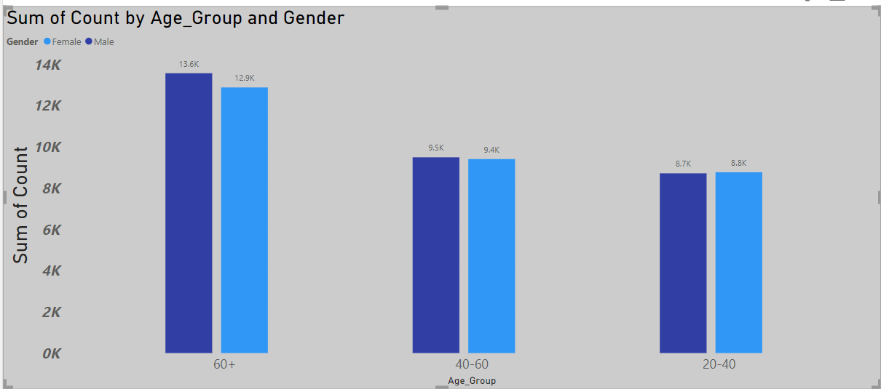

Slide 4
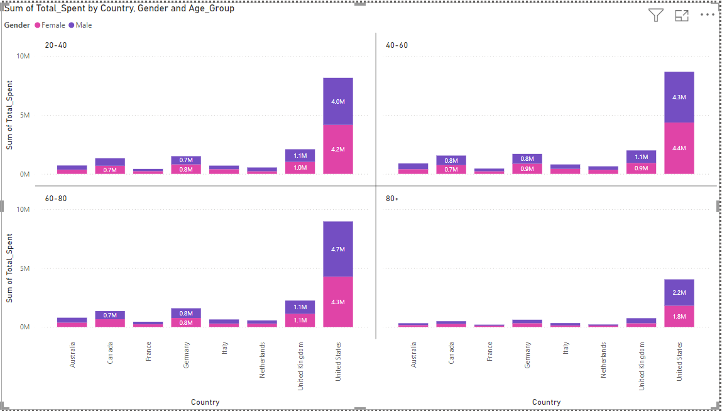
3.Segmentation: Segment customers based on demographics , Age Group and purchasing behavior to identify key customer groups.

Slide 5
Insight: Different age groups display distinct purchasing behaviors.
Recommendation: Segment marketing efforts based on age groups. For younger demographics with higher purchase frequency, promote tech-oriented products.
For older customers, focus on customer service and reliability.

Slide 6
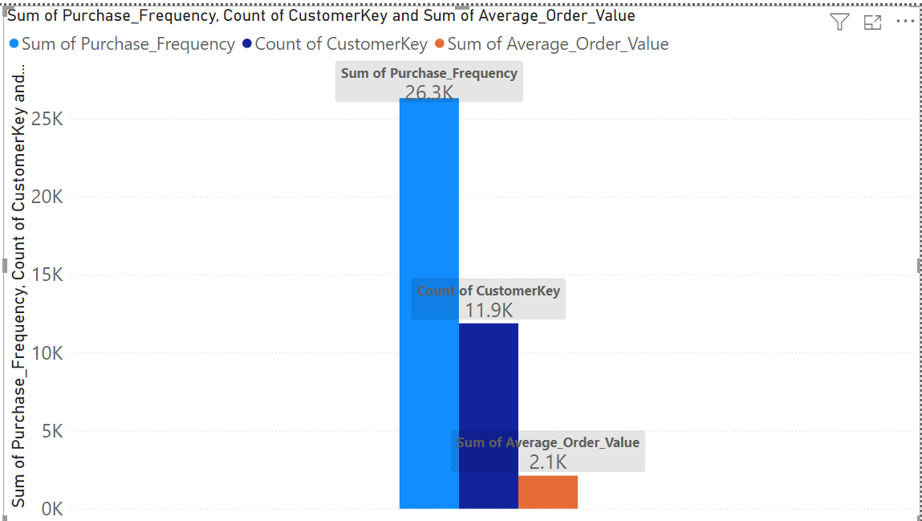
2.Purchase Patterns: Identify purchasing patterns such as average order value, frequency of purchases

Slide 7
Insight: Variations in average order value and frequency indicate that some customer segments purchase more frequently.
Recommendation: For customers with lower frequency but high order value, introduce loyalty programs or personalized discounts to encourage more frequent purchases.
For frequent buyers, introduce upselling or cross-selling strategies.

Slide 8
Sales Analysis

Slide 9
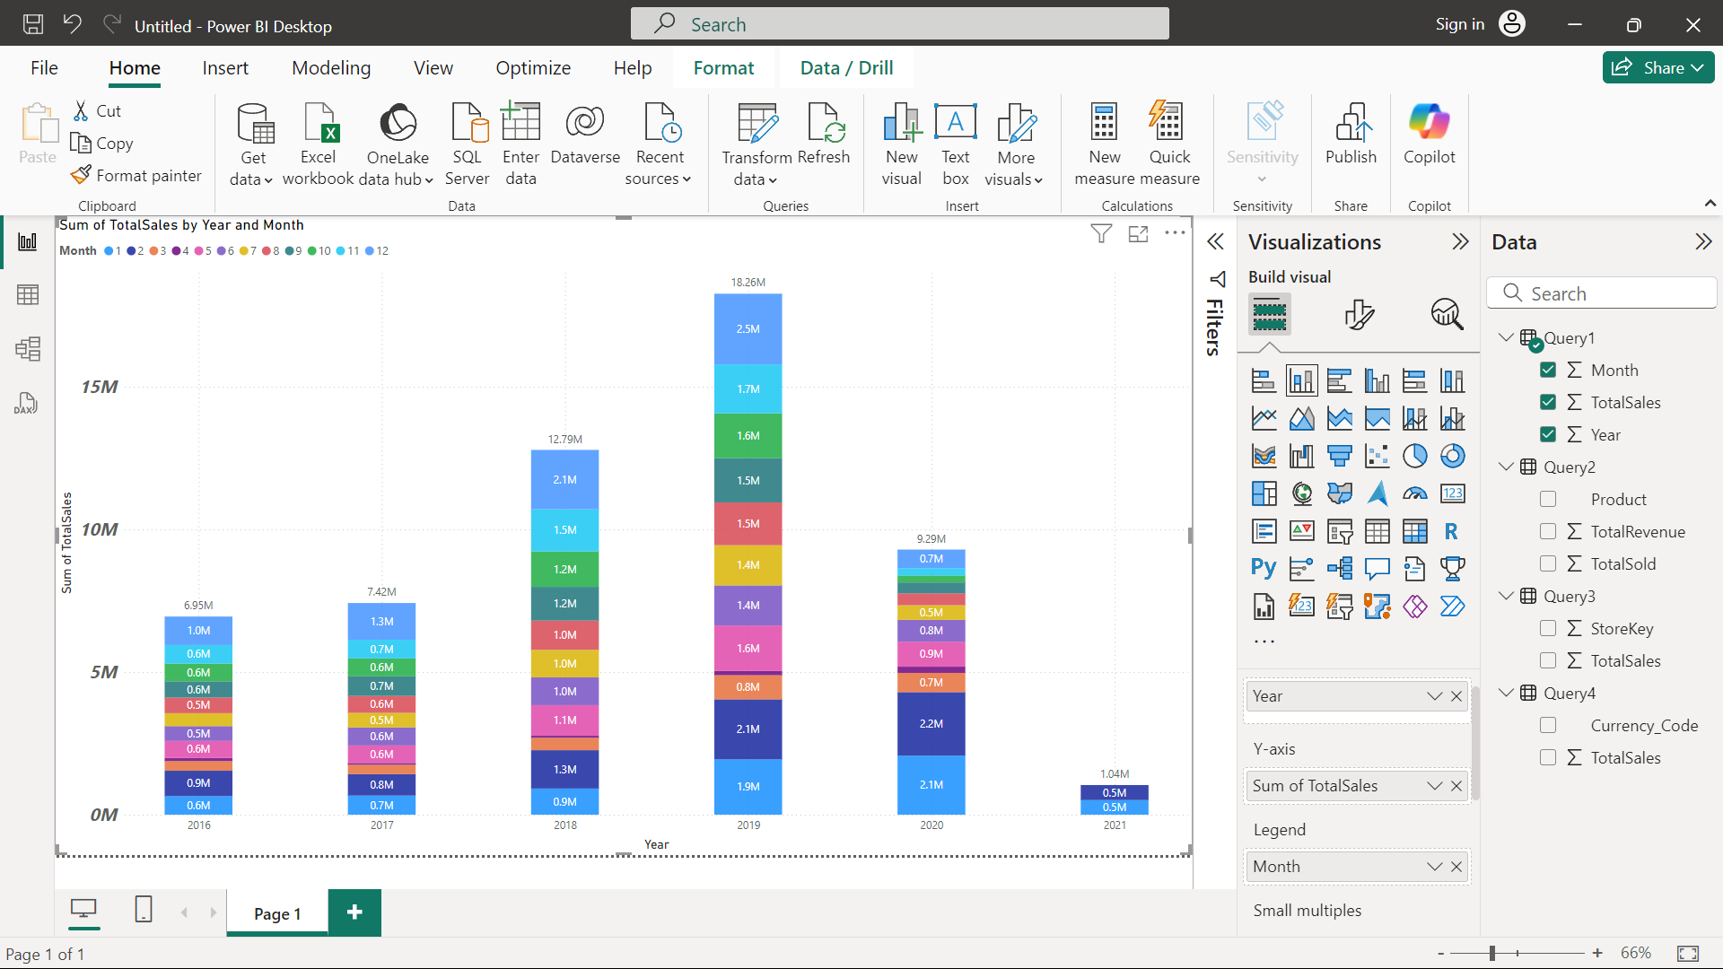
1.Overall Sales Performance: Total sales over time

Slide 10
Insight: Sales performance shows seasonal trends and fluctuations.
The Overall Sales Performance in the year 2019 pre covid the sales hits the highest with 18.26 million followed by 2018 with 12.79 million then 2020 with 9.29 million then 2017 with 7.42 million then 2016 with 6.95 million and the least 2021 where the covid hits very hard sales were only 1.04 million .
The pre covid sales in 2019 and before it also eventually good and with in it the highest sales happened in the month of Christmas in the December
Recommendation: Increase marketing efforts during peak seasons identified in the sales performance visual. Additionally, plan for inventory adjustments to match peak demand periods, ensuring high-demand products are well-stocked.

Slide 11
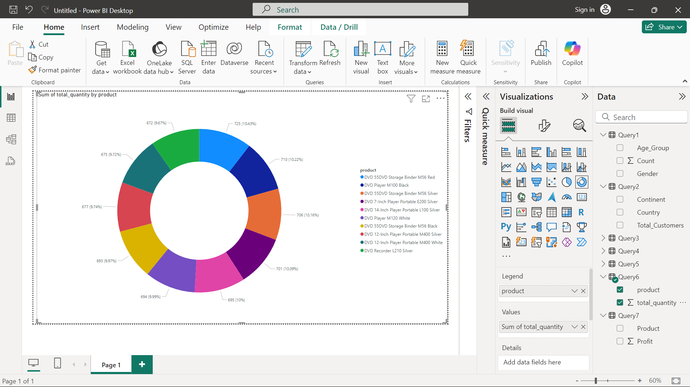
2.Sales by Product: Products are the top performers in terms of quantity sold

Slide 12
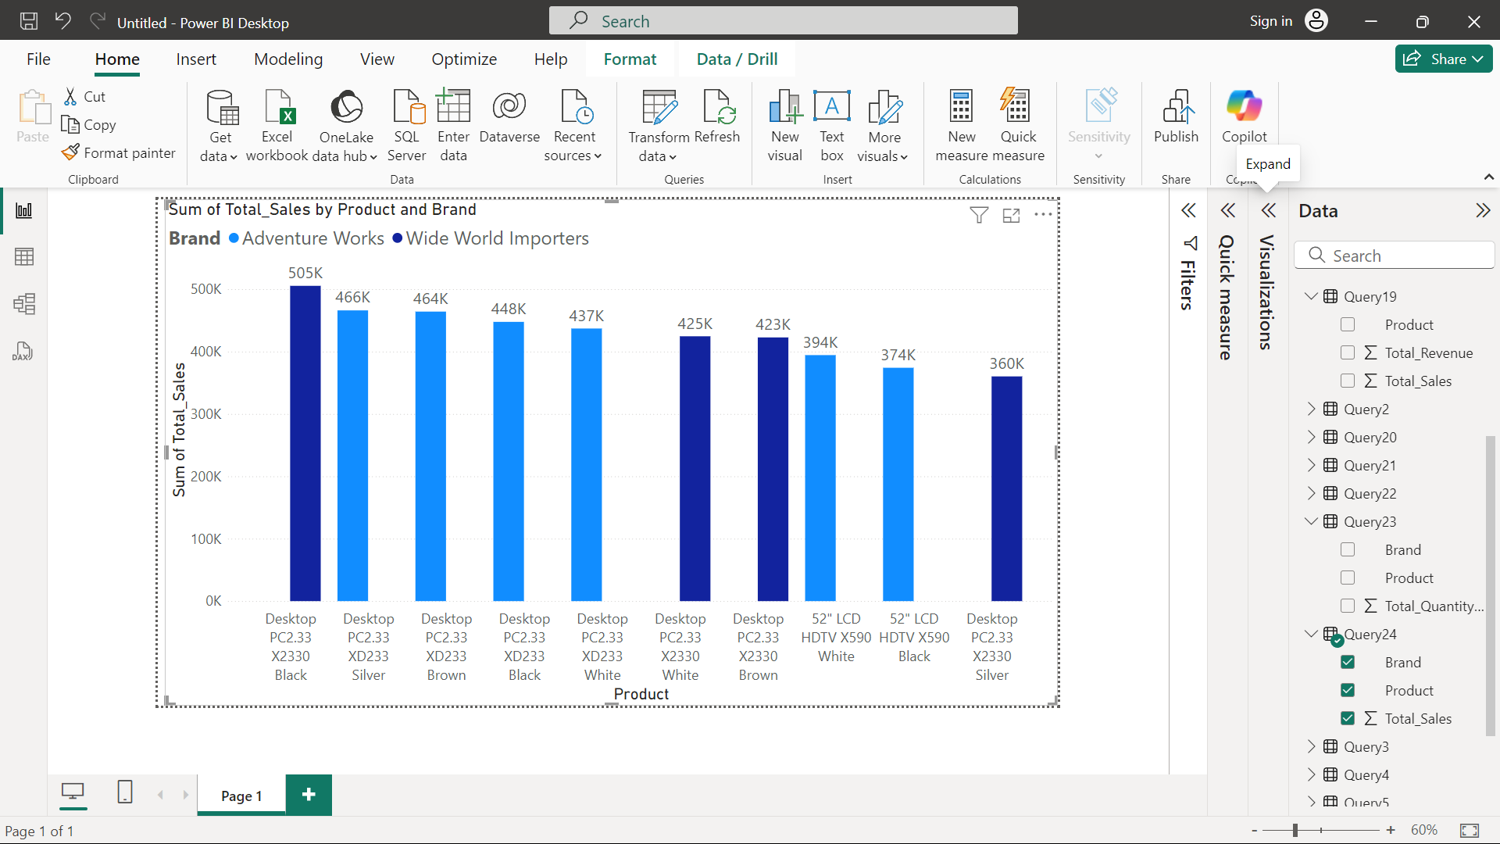
3.Sales by Product: Products are the top performers in terms of revenue generated.

Slide 13
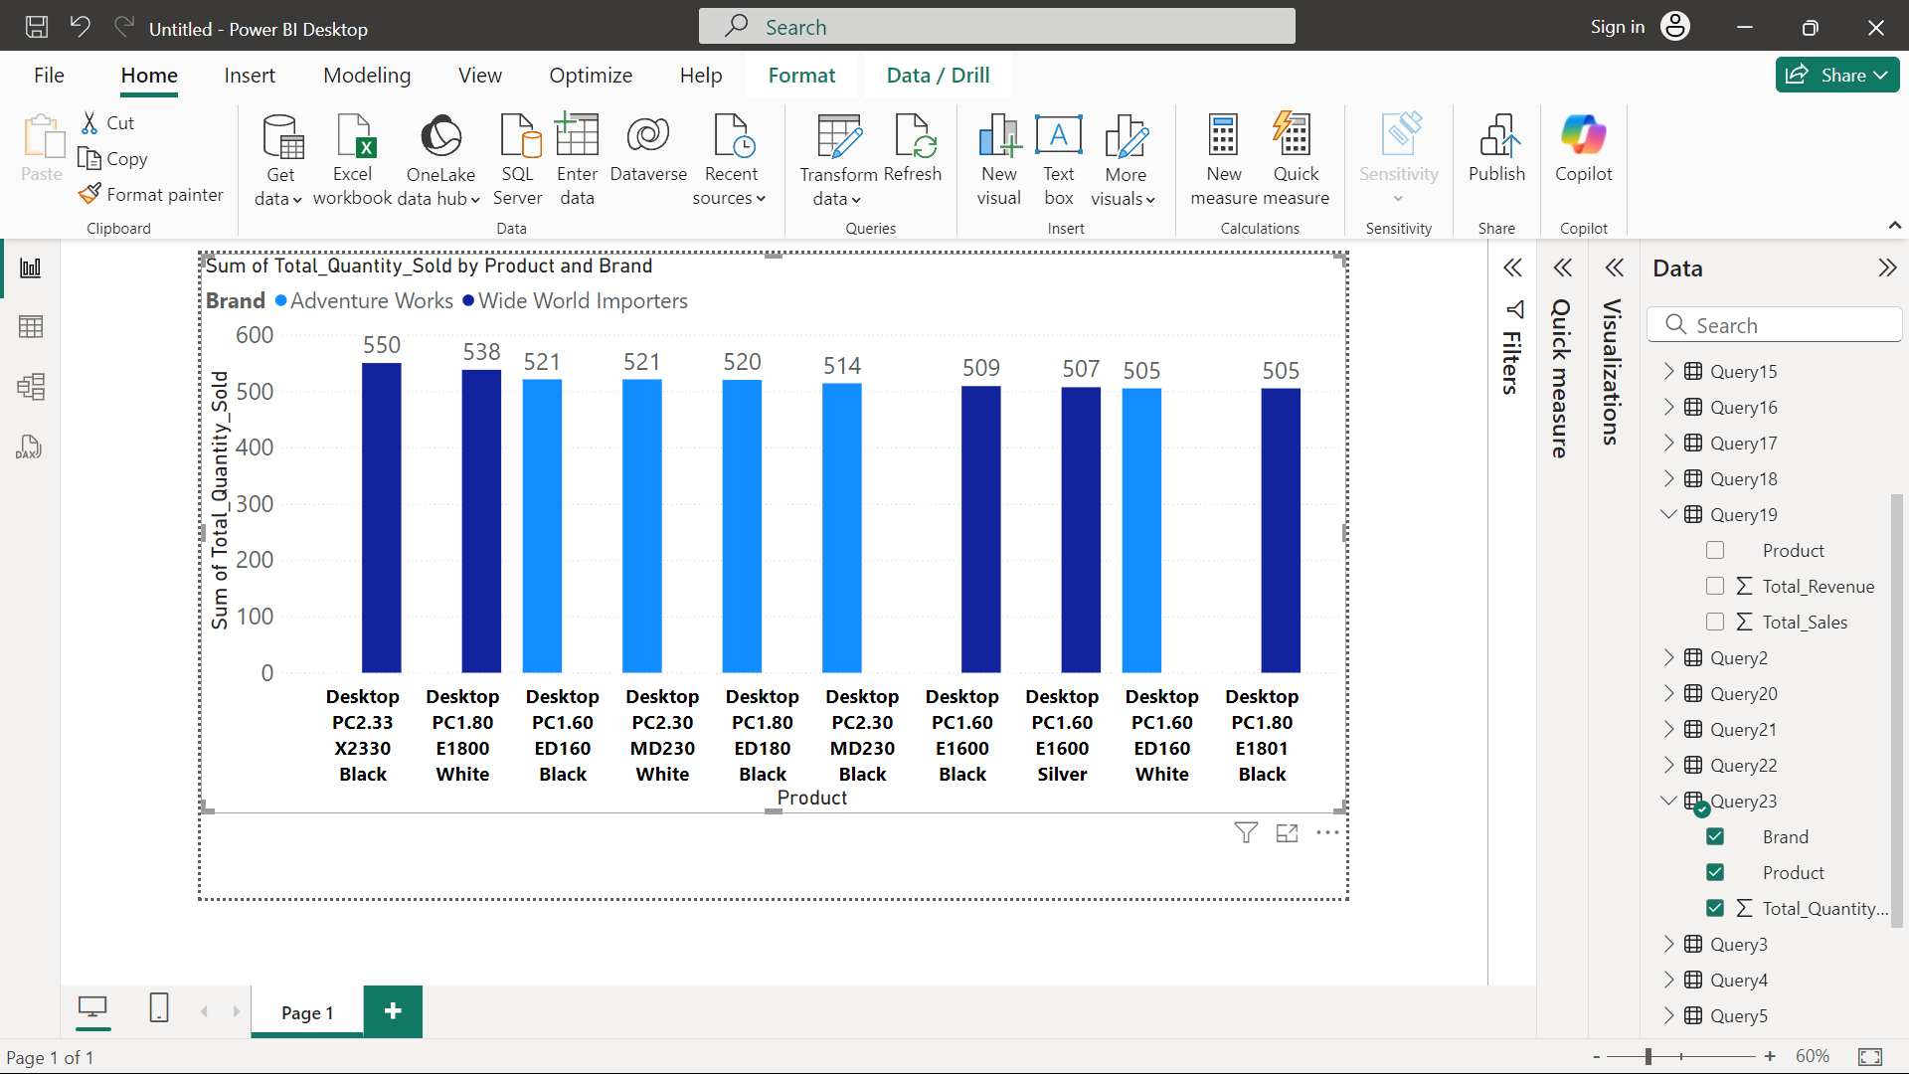

Slide 14
Insight: Certain products are top performers in both quantity sold and revenue.
In terms of the Quantity sold products the top 10 products were all the DVD’s.
In terms of revenue generated product in top 10 products 8 were the desktop and 2 were the TV’s and in this 2 Brands were competing with each other the Adventure Works & the Wide World Importers . So in the TV’s Adventure Works sold the highest and generated highest revenue whereas in desktop Wide World Importers sold the highest with 505k revenue and sold 550 desktop and on 2nd Adventure Works with 466K revenue and sold 538 desktop
Recommendation: Focus marketing and sales efforts on the top-performing products. Bundle popular products with lower-performing items to clear inventory. Products with high revenue but low quantities sold can benefit from premium positioning or targeted ads.

Slide 15
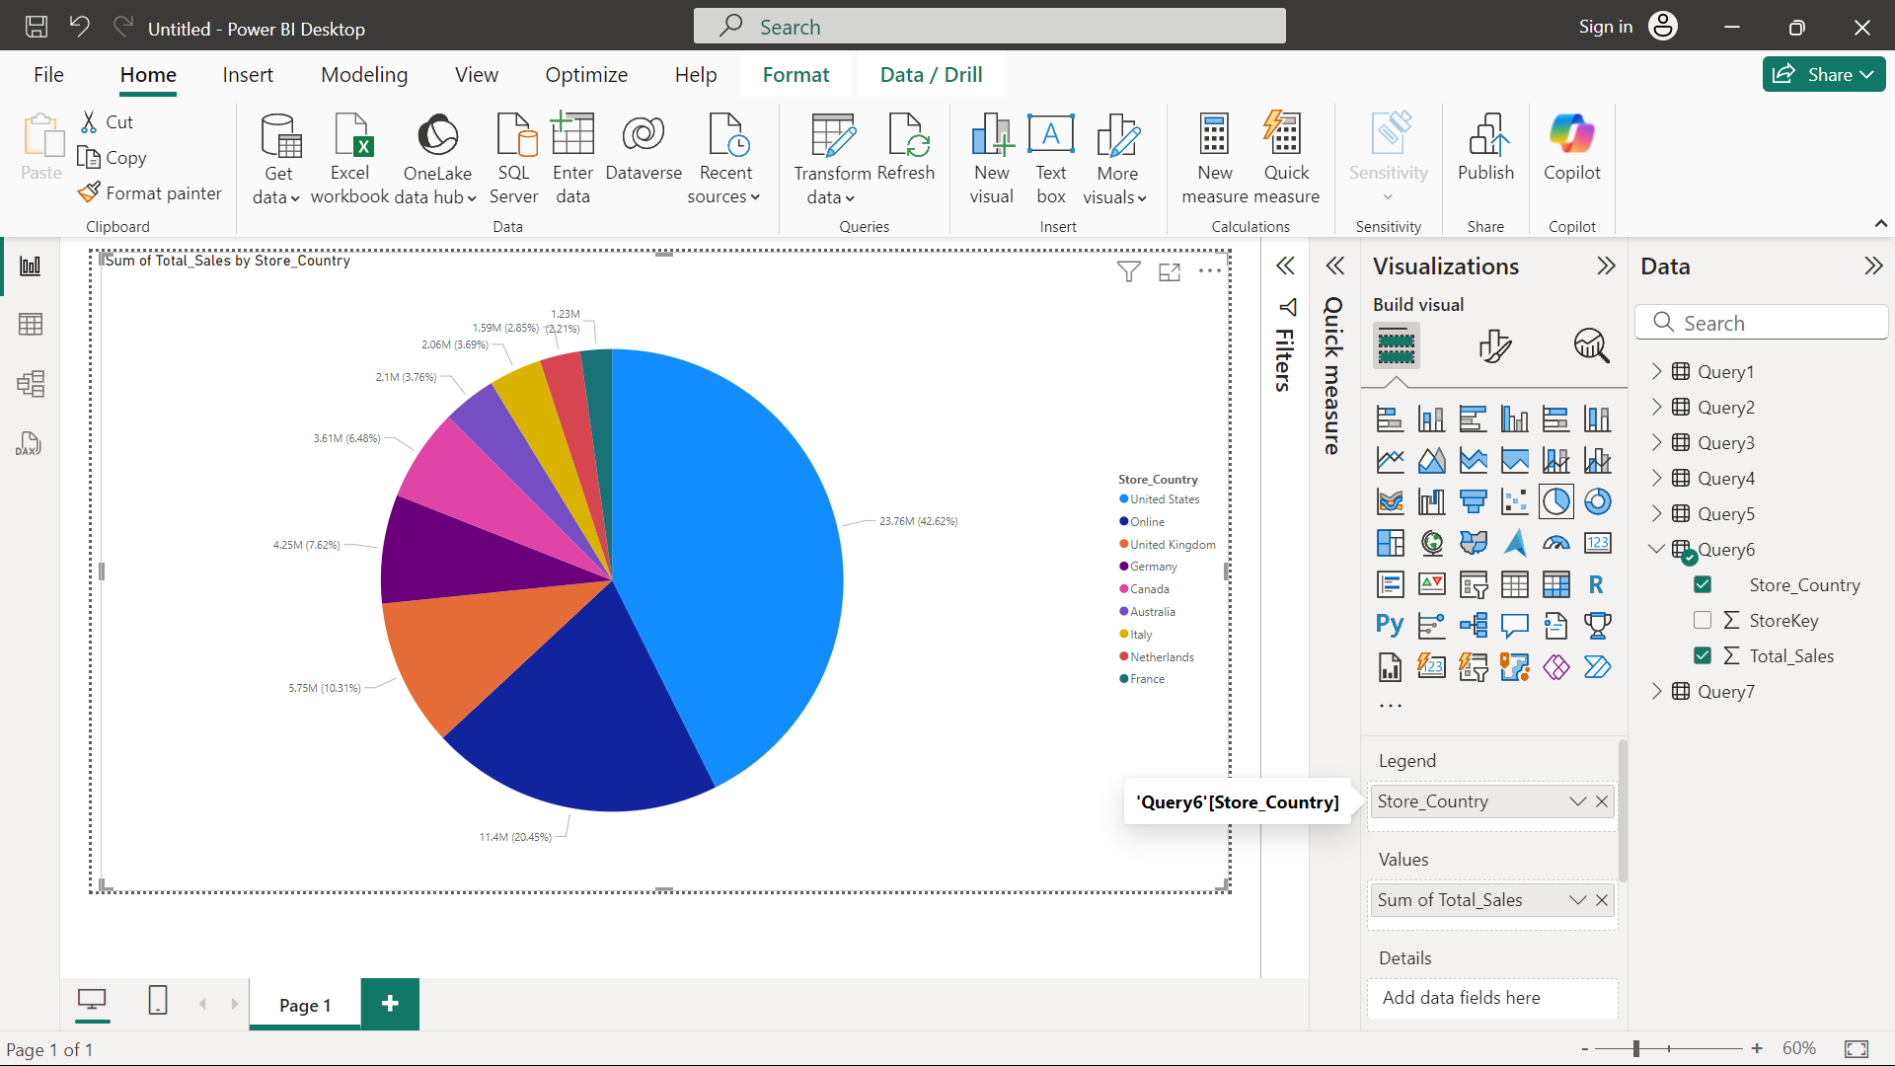
4.Sales by Store: Performance of different stores based on sales data.

Slide 16
Insight: Different stores have varying performance based on sales data.
Recommendation: Allocate more resources (e.g., inventory, staffing, promotional activities) to high-performing stores.
Identify and address factors contributing to underperformance in weaker stores this may involve local marketing efforts or adjustments to the product mix.

Slide 17
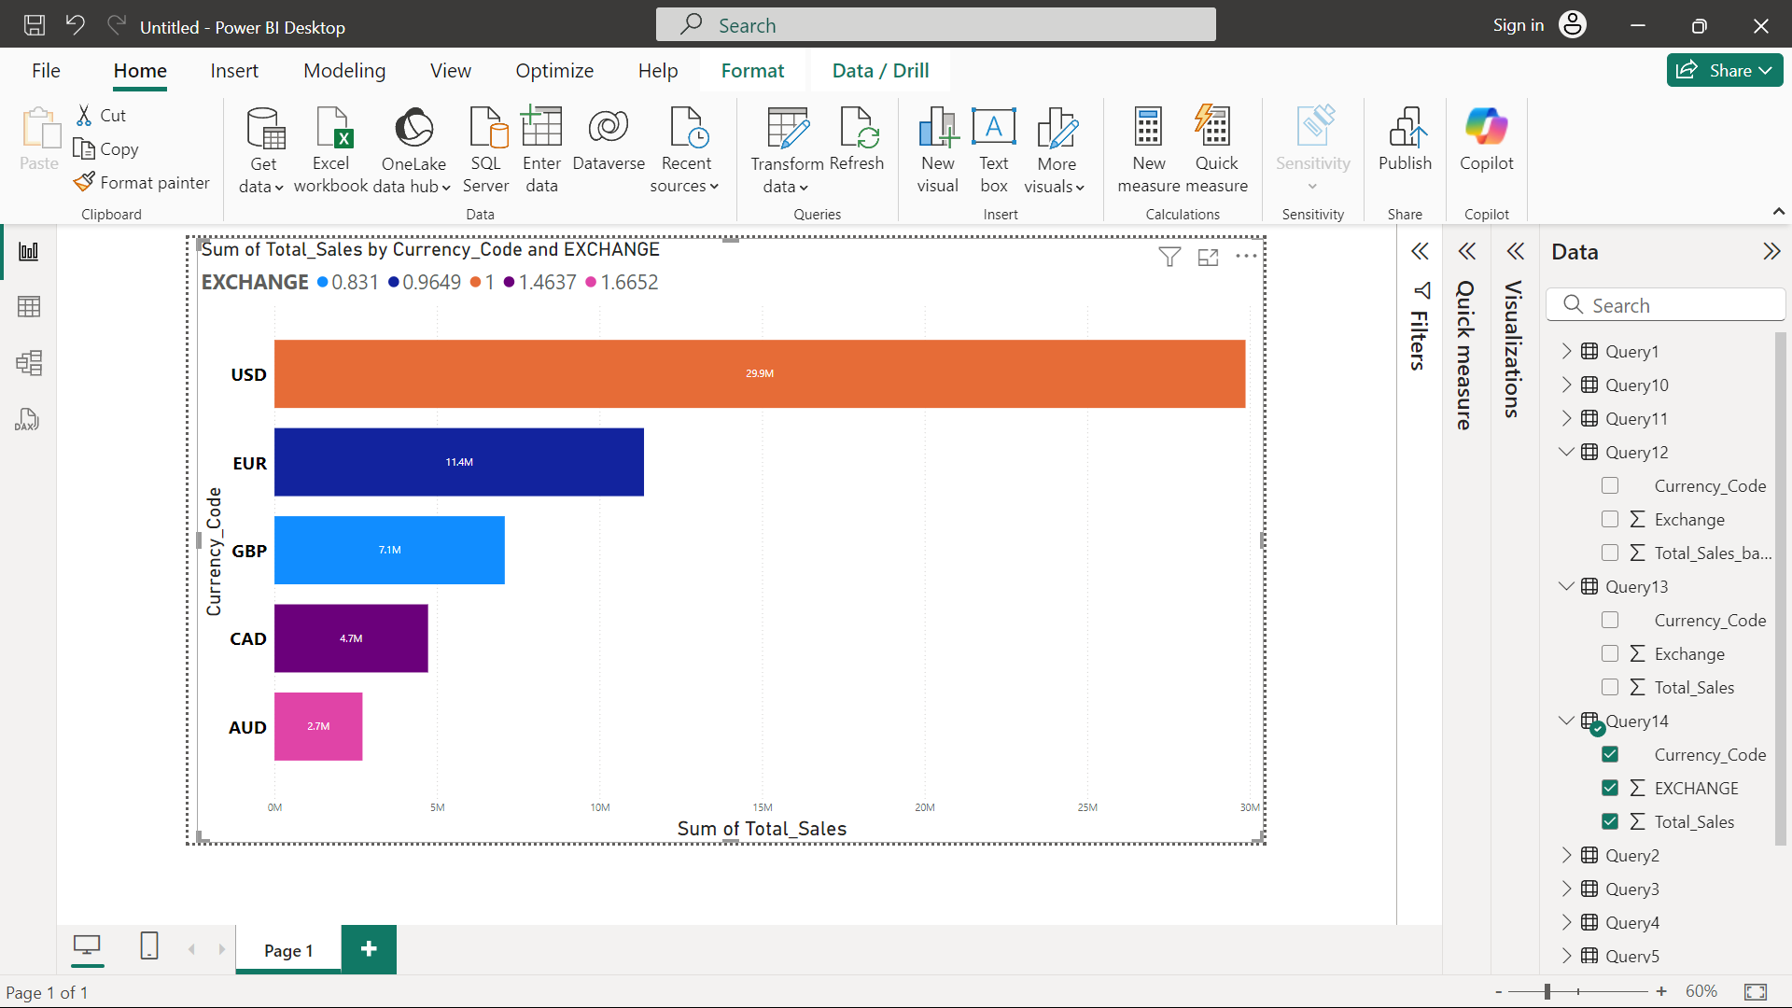
5.Sales by Currency: Different currencies impact sales figures, considering exchange rates.

Slide 18
Insight: Sales performance is impacted by currency fluctuations.
Recommendation: Regularly adjust pricing strategies in regions affected by currency exchange rates to maintain profitability.
For regions where sales are heavily impacted by currency devaluation, consider alternative pricing models like dynamic pricing.

Slide 19
Product Analysis

Slide 20
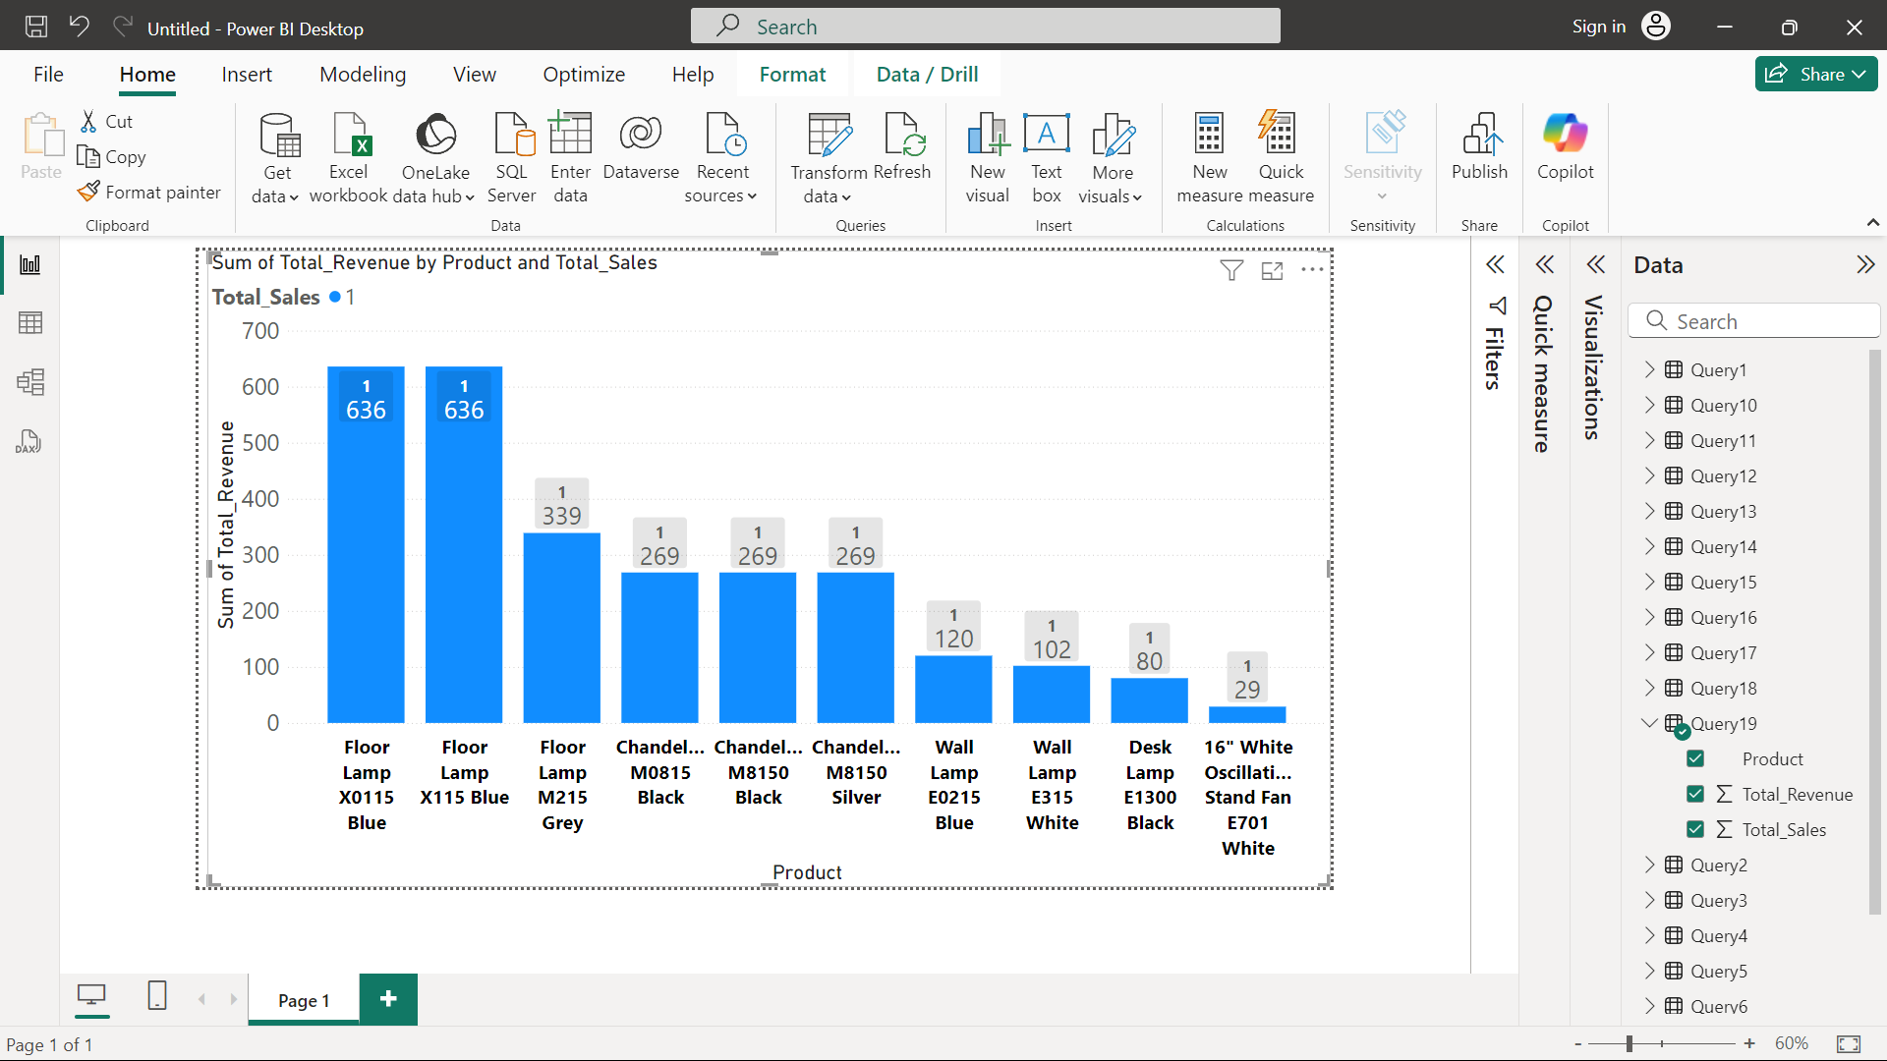
1.Product Popularity: Least popular products based on sales data.

Slide 21
Insight: Certain products consistently underperform based on sales.
Recommendation: Reevaluate the product mix and phase out or revamp the least popular products. Consider redistributing inventory of underperforming products to regions where they may perform better based on local demand.
Focus R&D efforts on developing more products in top-performing categories.

Slide 22
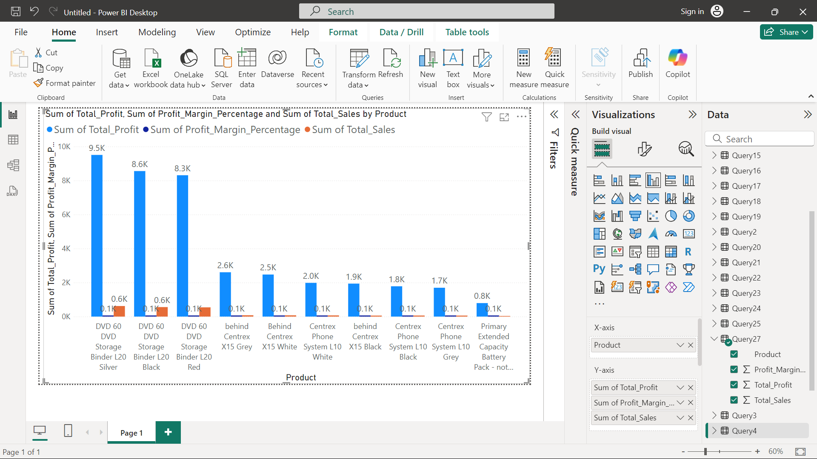
2.Profitability Analysis: Profit margins for products by comparing unit cost and unit price

Slide 23
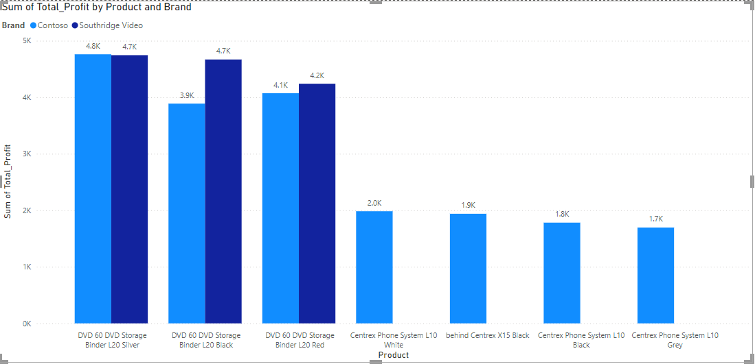

Slide 24
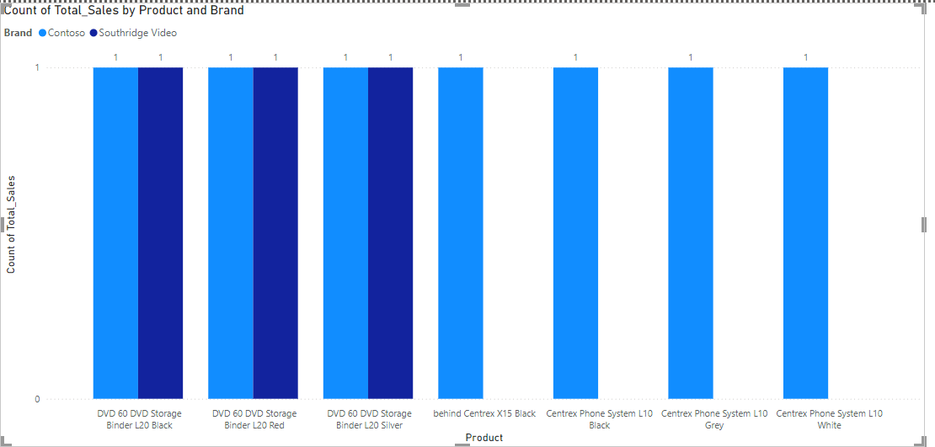

Slide 25
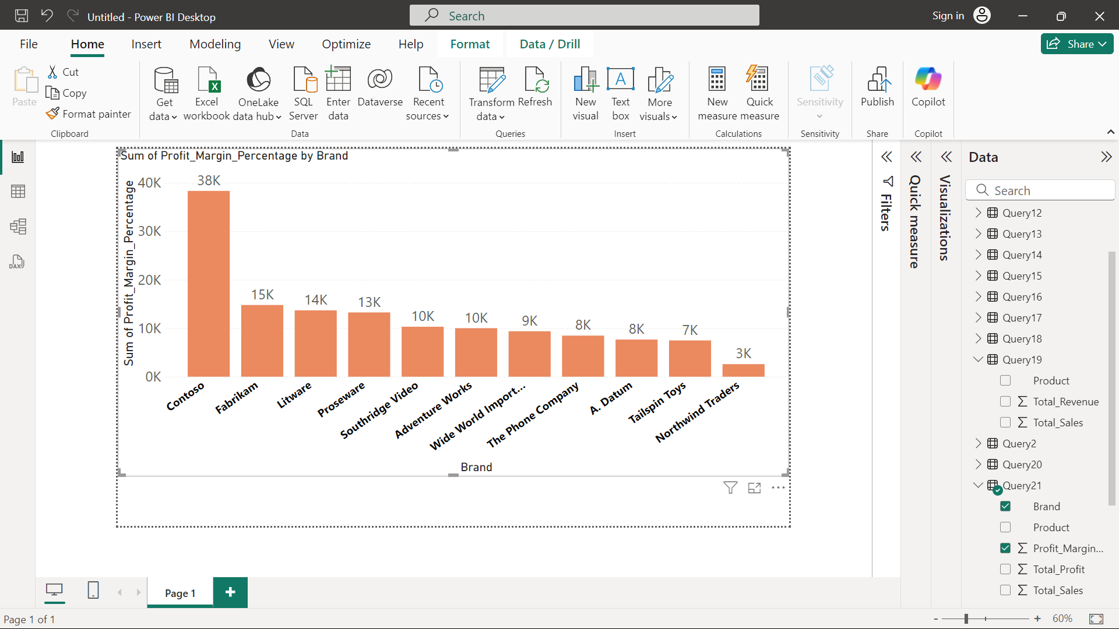

Slide 26
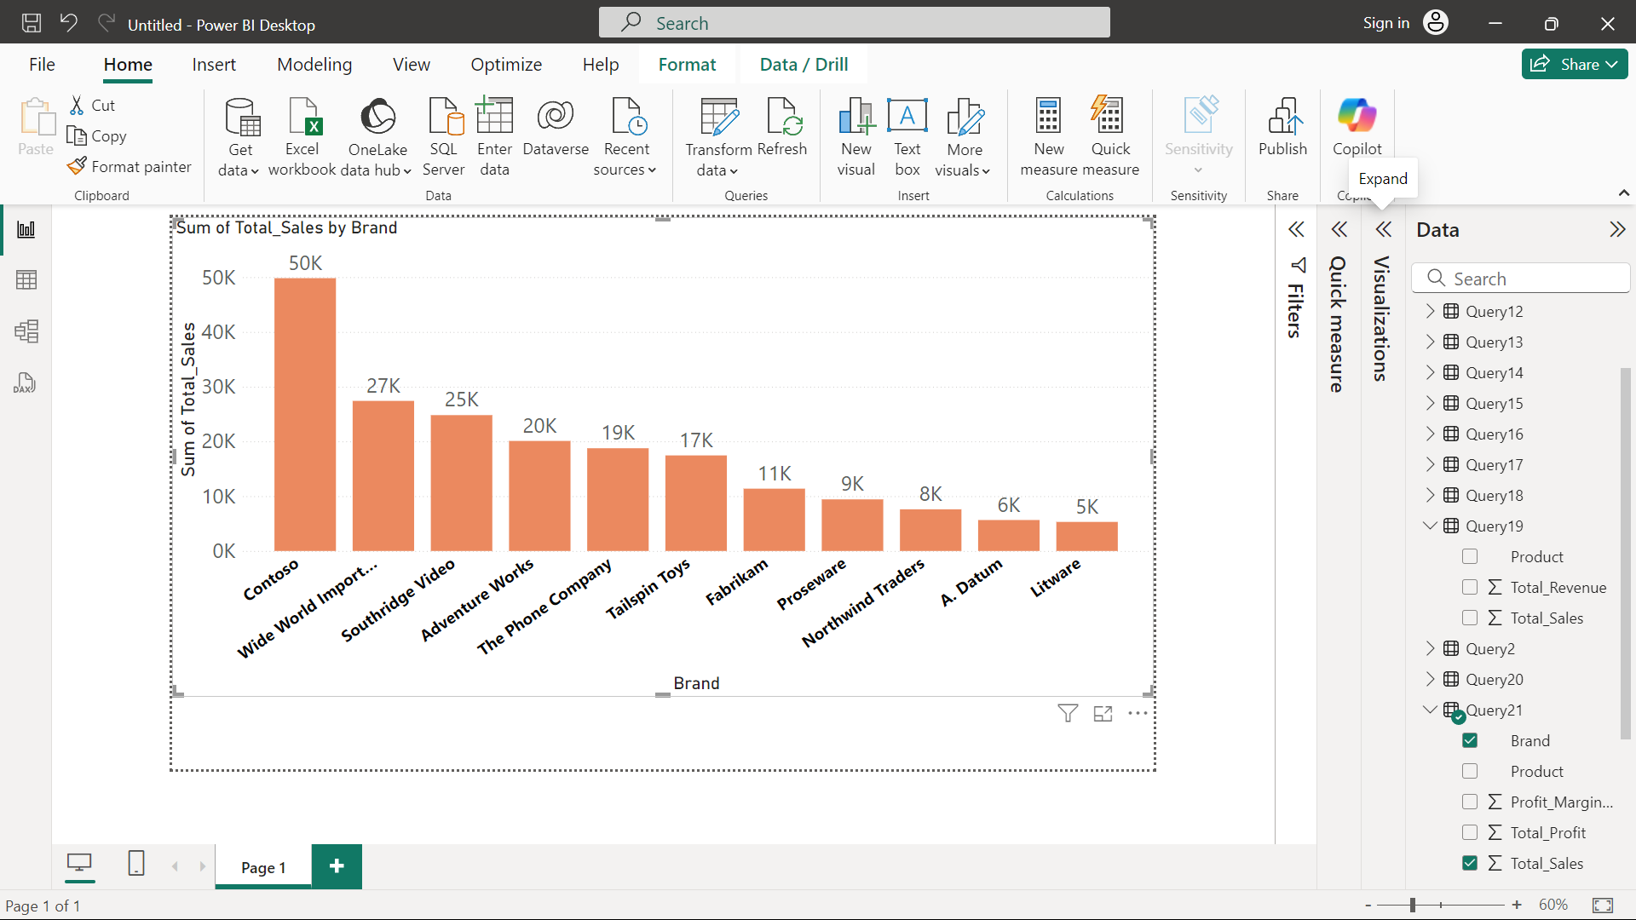

Slide 27
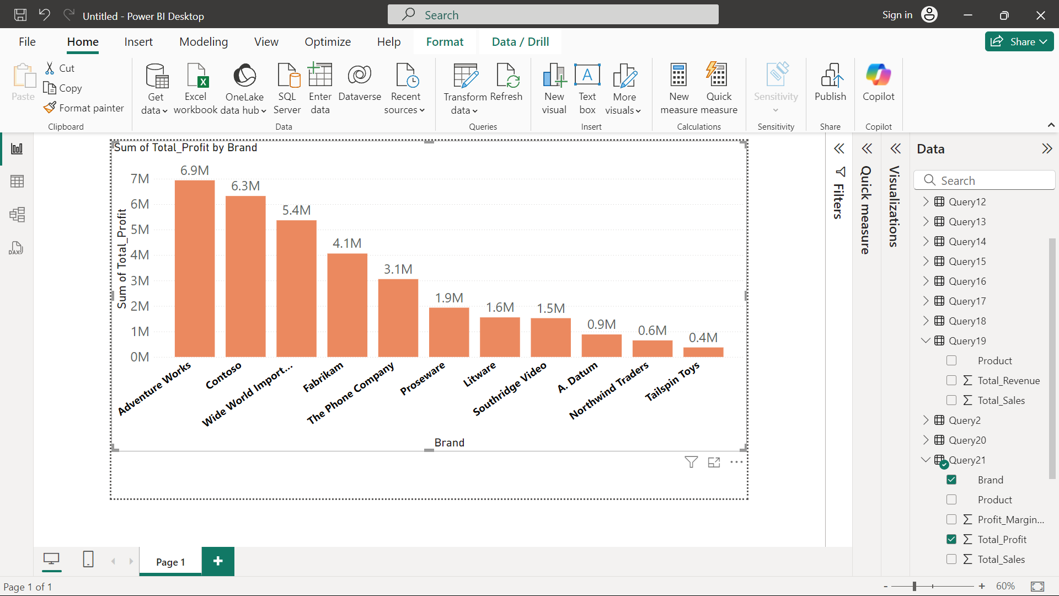

Slide 28
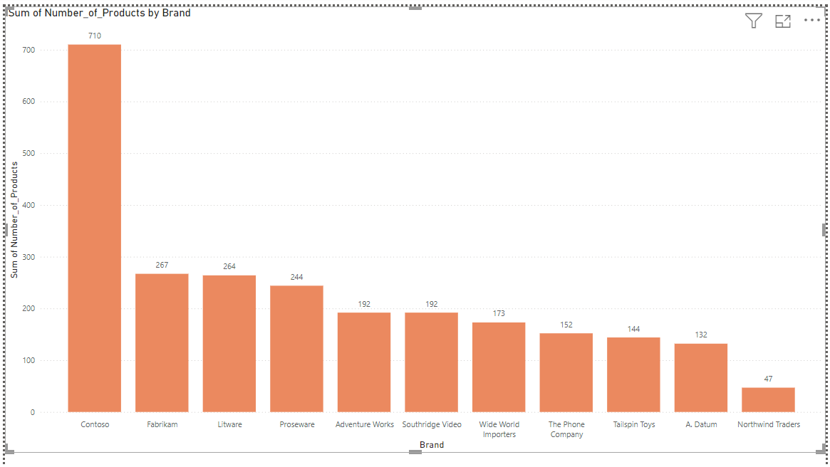

Slide 29
Insight: Variability in product profitability.
Top 10 least product are mostly the floor lamps , Wall lamp, Desk lamp
On the basis of the highest profit made by the product with respect to the sales DVD 60 L20 SILVER 0.6K unit sold with 9.5K profit , followed by DVD 60 L20 BLACK 0.6K Unit Sold with 8.6K profit, DVD 60 L20 RED 0.6K with 8.3K profit.
Brand 'Contoso' has the highest profit margin among all the products that company have 38K(sum of profit margin in % ) , 'Fabrikam' (15k) 'Litware' (14k) 'Proseware'(13k ) 'Southridge Video'(10k) 'Adventure Work’(10k) 'Wide World Importers'(9k) 'A. Datum'(8k) 'The Phone Company'(8k) 'Tailspin Toys'(7k) 'Northwind Traders' (3k)
Total sales by a brand 'Contoso' has the highest sales among all the products that company have (50k), 'Wide World Importers'(27k), 'Southridge Video'(25k), 'Adventure Works'(20k), 'The Phone Company'(19k), 'Tailspin Toys'(17k), 'Fabrikam(11k), 'Proseware'(9k), 'Northwind Traders'(8k), 'A. Datum'(6k), Litware(5k).
The profit made by a brand across all the products they have 'Adventure Work’(6.9Million), Contoso (6.3 Million), Wide World Importer(5.4 Million),Fabrikam(4.1 Million), The Phone Company(3.1 Million), Proseware(1.9million)
Contoso brand has the highest no. of products(710) but the brand making highest profit is Adventure Work it is because Contoso value of the products ,the products Adventure Work have , has the high value comparing to Contoso.
Recommendation: For products with low profit margins, explore opportunities to reduce costs, such as through negotiations with suppliers or optimizing production processes.
Prioritize promoting products with higher margins to maximize overall profitability.

Slide 30
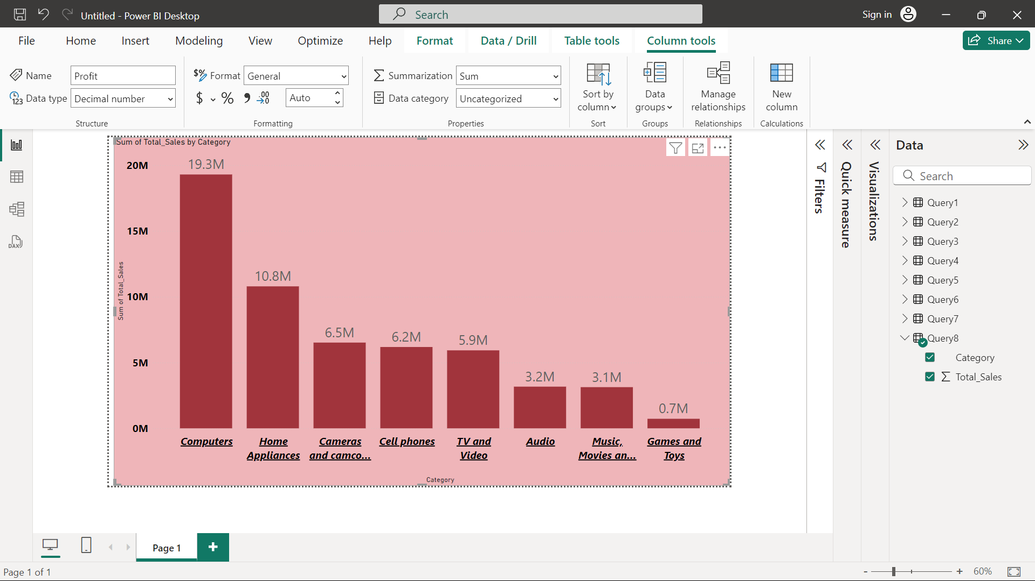
3.Category Analysis: Sales performance across different product categories and subcategories.

Slide 31
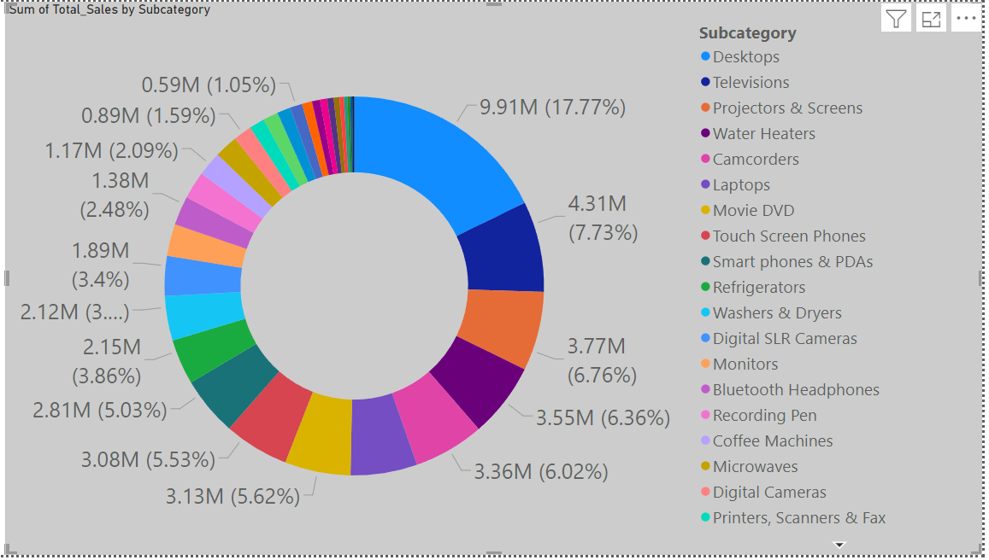

Slide 32
Insight: Differences in performance across categories and subcategories.
Recommendation: Invest in expanding product lines within high-performing categories.
For underperforming categories, conduct further market research to determine customer preferences, and consider introducing new subcategories or discontinuing underperforming ones.

Slide 33
Store Analysis

Slide 34
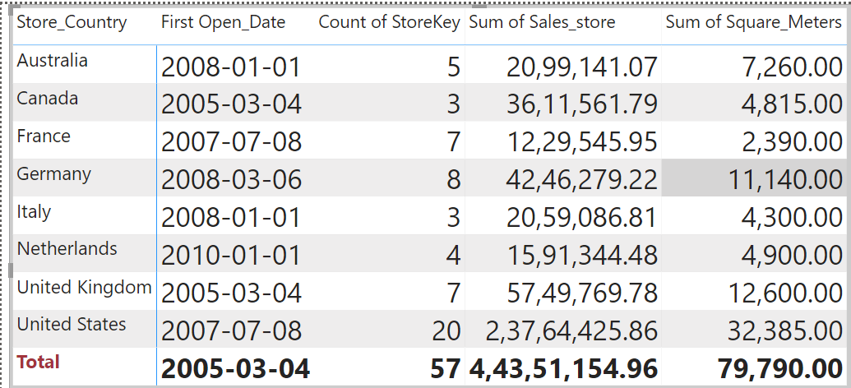
1.Store Performance: Evaluate store performance based on sales, size (square meters), and operational data (open date) ,sales by store location to identify high-performing regions.

Slide 35
Store Performance: Sales and Size Correlation
Insight: Store performance varies with size and sales.
Recommendation: Consider expanding the size of high-performing stores to accommodate more inventory and drive higher sales.
For underperforming larger stores, explore downsizing or optimizing the product layout to enhance efficiency and profitability.
B. Store Location Performance
Insight: Certain regions show stronger sales.
Recommendation: Prioritize expansion in high-performing regions.
For regions with lower sales, adjust marketing strategies to boost awareness, or reconfigure the product mix to better match local preferences.

